Slide 1

Twitter Bot Detection
By
Madhu Kiran Gudivada(mg5309@nyu.edu)
Data Sainath

Slide 2
Motivation
Twitter is one of the most popular social media platforms, it has been plagued by many bots during recent years.
Bots can control the sentiment od an issues and can create a biased opinion about any situation.
For example during the election of 2016 a huge number of bots started a bad campaign against a Presidential candidate. Bots were know to flood about 24% of daily tweets with their negative ideas.
This has motivated the software community to deal with the issue seriously.

Slide 3
Data Retrieval
In order to create any classifier we need good variety of Twitter users and Twitter Bots.
There are many websites like botwiki.org which not only has a list of bots but also classifies them based on their tweets.
Users have been selected from our friends and know celebrities to have good mix of training data.
The Data of these uses is collected using Twitter’s RestAPI.

Slide 4
Data Preprocessing
Cleaning Data
Data Conversion
Training Data using Algorithm

Slide 5
Cleaning Data
Once the tweets has been collected it needs to be cleaned because tweets contain a lot of non textual data which cannot be used for training of the Algorithms.
We used nltk and regex packages to remove stop words , emoticons and hashtags .
To create a fine sparse matrix we have to stemmed the words.

Slide 6
Data Conversion
Once data has been cleaned we need to create a sparse matrix that contains the word frequency and distribution among the documents.
This is called a tf-idf matrix which is created using CountVectorizer functions of the nltk toolkit.

Slide 7
Algorithms Used
Multinomial Naïve Bayes
Bernoulli Naïve Bayes
Logistic Regression

Slide 8
Training and Cross Validation
After choosing the appropriate algorithms we went on to train and run a 10-Fold cross validation and took average of the results for the following constrains:
 | MultinoialNB | BernoulliNB | LogisticReg
accuracy | 0.7305 | 0.7227 | 0.7357
precision | 0.7929 | 0.8159 | 0.7855
recall | 0.7396 | 0.6879 | 0.7621
f1 score | 0.7634 | 0.7436 | 0.7724
roc_auc | 0.8121 | 0.8146 | 0.8108

Slide 9
Remarks
Although in theory using tweets to identify bots sounded good but after implementation the results were not up to the mark.
This is because bot’s have evolved during the recent times with the advancement in Artificial Intelligence the bots have become very good in concealing themselves.
Today there bots in twitter that can create new poems, be interactive with it’s followers and also wish them on their birthdays.

Slide 10
OUR NEW ALGORITHM
We have used sentimental analysis and decision trees on the major attributes: TRAINING ACCURACY : 80.1%
REASONS FOR CHOOSING AN ALGORITHM: 1. Need to scrub/clean the bot data (Due to inaccurate labelling) 2. Identify the user accounts.
CONSIDERATION FOR ALGORITHM! 1. Attributes of a twitter account like (screen name, name, description, statuses count, followers count, friends count) 2. The best data set are our personal user and bot data set and crowdsourced user data.

Slide 11
FIRST STEP
Screen Names
‘BOT’
Name
Description
CHANGES MADE: VALUE CHANGED TO 2
DRAWBACK: A legitimate user may have a phrase like ‘bottle’, ‘botany’
MEASURE: We have avoided this false positive in the future steps

Slide 12
CONCLUSIONS FROM FIRST STEP (USER DATA)
PERSONAL USER DATA SET
TRAINING USER DATA SET
Accuracy of finding bot word: 0%
Accuracy of finding bot word: 1.5%

Slide 13
CONCLUSIONS FROM FIRST STEP (BOT DATA)
PERSONAL BOT DATA SET
TRAINING USER DATA SET
29 of 50 accounts discovered
388 of 1323 accounts discovered
Accuracy of finding bot word: 58%
Accuracy of finding bot word: 29.33%

Slide 14
SECOND STEP
0 statuses
BEGINNER USER ACCOUNT
0 followers
0 friends
PERSONAL USER DATA SET ACCURACY: 0%
PERSONAL BOT DATA SET ACCURACY: 4% (2)
TRAINING USER DATA SET ACCURACY: 1.626% (24)
TRAINING BOT DATA SET ACCURACY: 19% (250)

Slide 15
THIRD STEP
TWEETS TO FRIENDS RATIO < 12
TWEETS TO FOLLOWERS RATIO <12
Recognizing the common users

Slide 16
CONCLUSIONS FROM THIRD STEP (PERSONAL USER DATA)
ACCURACY: 100%

Slide 17
CONCLUSIONS FROM THIRD STEP (PERSONAL BOT DATA)
ACCURACY: 2%

Slide 18
CONCLUSIONS FROM THIRD STEP (TRAINING USER DATA)
ACCURACY: 89.7%

Slide 19
CONCLUSIONS FROM THIRD STEP (TRAINING BOT DATA)
ACCURACY: 16.7%

Slide 20
FOURTH STEP
VERIFIED
YES
NO
USERS
BOTS

Slide 21
CONCLUSIONS FROM FOURTH STEP (USER DATA)
ACCURACY: 52%
ACCURACY: 43.7%

Slide 22
CONCLUSIONS FROM FOURTH STEP (BOT DATA)
ACCURACY: 0%
ACCURACY: 0.6%

Slide 23
FIFTH STEP (CLEVER BOTS)
NO ’BOT’ IN SCREEN NAME, NAME & DESCRIPTION
TWEETS TO FRIENDS RATIO >10
TWEETS TO FOLLOWERS RATIO >10
Recognizing the clever bots

Slide 24
ACCURACY CALCULATION
USER DETECTION
OUR USER DATA SET ACCURACY: 100%
TRAINING USER DATA SET ACCURACY: 98.3%
BOT DETECTION
OUR BOT DATA SET ACCURACY: 90%
TRAINING BOT DATA SET ACCURACY: 65%

Slide 25
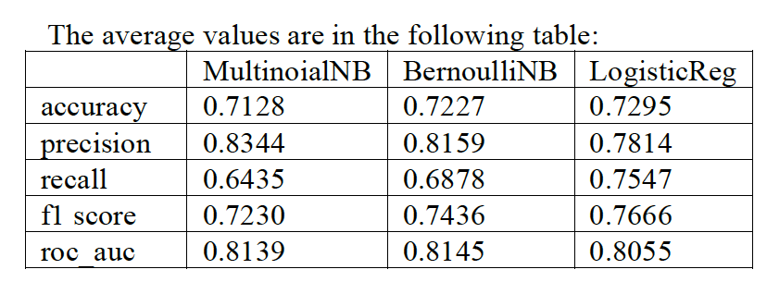
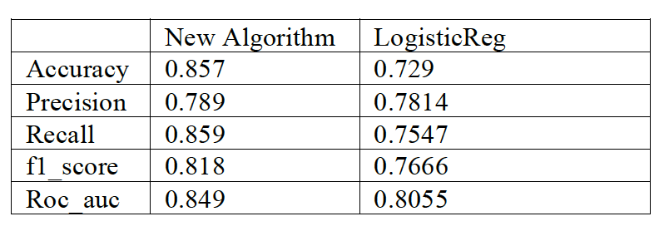
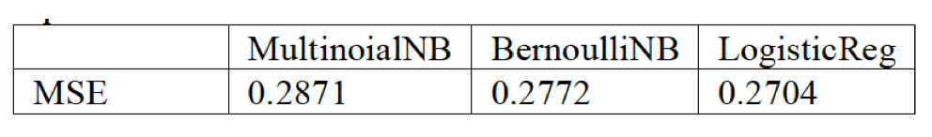
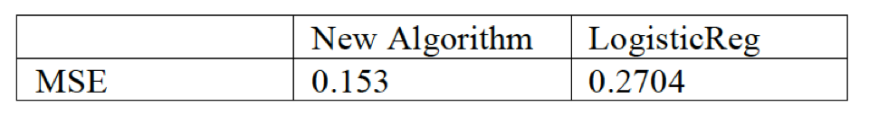
PERFORMANCE ANALYSIS

Slide 26
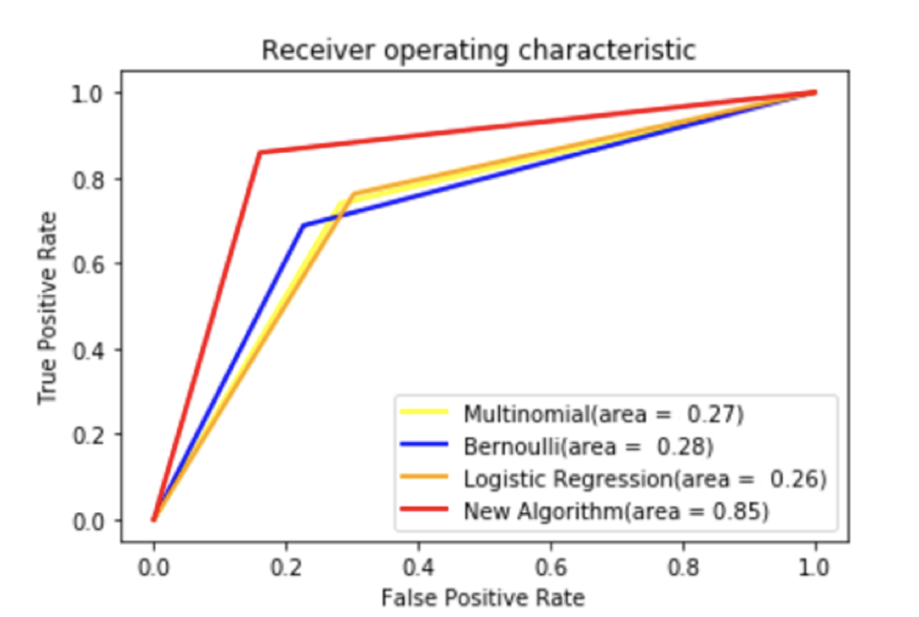
RECEIVER OPERATING CHARACTERISITCS

Slide 27
FUTURE WORK
Sentimental Analysis
Friends Hierarchy
User metadata
Behavior Features

Slide 28
THANK YOU

